Slide 1


Customer Churn Analysis in E-Commerce
This presentation explores customer churn in e-commerce. It focuses on using SQL for data analysis. We cover data cleaning, transformation, and key insights. The goal is to provide actionable strategies for reducing churn.
by Navina Jolene

Slide 2
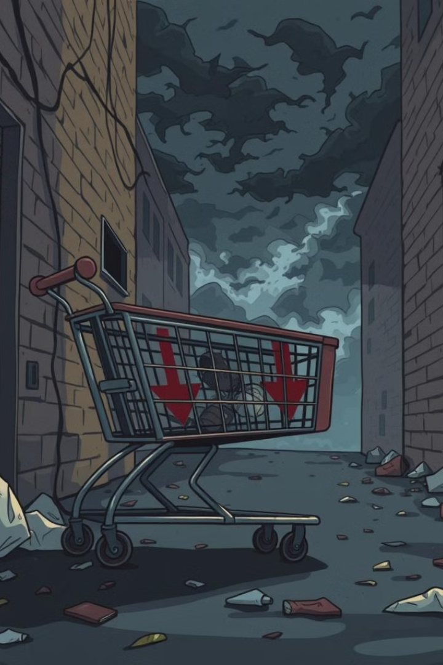
Project Overview
Churn patterns
SQL Analysis
Understand customer churn patterns in e-commerce. Find out why customers are leaving.
Use SQL to analyze customer transactions and churn factors. Get the most out of your data.
Reduce churn
Provide actionable insights to reduce churn. Keep valuable customers.

Slide 3

Data Cleaning & Transformation
Missing values
Outliers
Handle missing values using mean/mode imputation. Ensure data completeness.
Remove outliers (e.g., WarehouseToHome > 100). Improve data accuracy.
Standardize values
Standardize data values (e.g., 'COD' → 'Cash on Delivery'). Maintain consistency.

Slide 4

SQL Queries for Data Cleaning
-- Handling Missing Values UPDATE customer_churn SET WarehouseToHome = (SELECT ROUND(AVG(WarehouseToHome)) FROM customer_churn WHERE WarehouseToHome IS NOT NULL) WHERE WarehouseToHome IS NULL; -- Removing Outliers DELETE FROM customer_churn WHERE WarehouseToHome > 100;
These SQL queries address common data quality issues. They ensure that subsequent analysis is based on reliable data. Adapt these queries to your specific database schema.

Slide 5

Data Exploration & Key Insights
1
Churn vs Active
Count of churned vs. active customers. Assess the overall churn rate.
2
Complaints
Relationship between complaints and churn. See if complaints lead to churn.
3
Payment Mode
Most preferred payment mode among active customers. Optimize payment options.
4
Order Behavior
Order behavior analysis. Find patterns in customer purchases.

Slide 6

SQL Queries for Data Analysis
-- Count of Churned vs. Active Customers SELECT ChurnStatus, COUNT(*) AS CustomerCount FROM customer_churn GROUP BY ChurnStatus; -- Percentage of Churned Customers Who Complained SELECT (COUNT(*) * 100.0 / (SELECT COUNT(*) FROM customer_churn WHERE ChurnStatus = 'Churned')) AS ComplaintPercentage FROM customer_churn WHERE ChurnStatus = 'Churned' AND ComplaintReceived = 'Yes';
The SQL queries provide valuable insights. They highlight the importance of customer satisfaction. High complaint percentages indicate areas for improvement. Track key metrics for early warning signs.

Slide 7
Returns & Customer Complaints Analysis
Churned complaints
Return patterns
SQL Joins
Analyze customers who churned and made complaints. Address the root causes of churn.
Identify patterns in product returns. Improve product quality.
Use SQL joins to merge return data with churn data. Get a complete picture of churn.

Slide 8
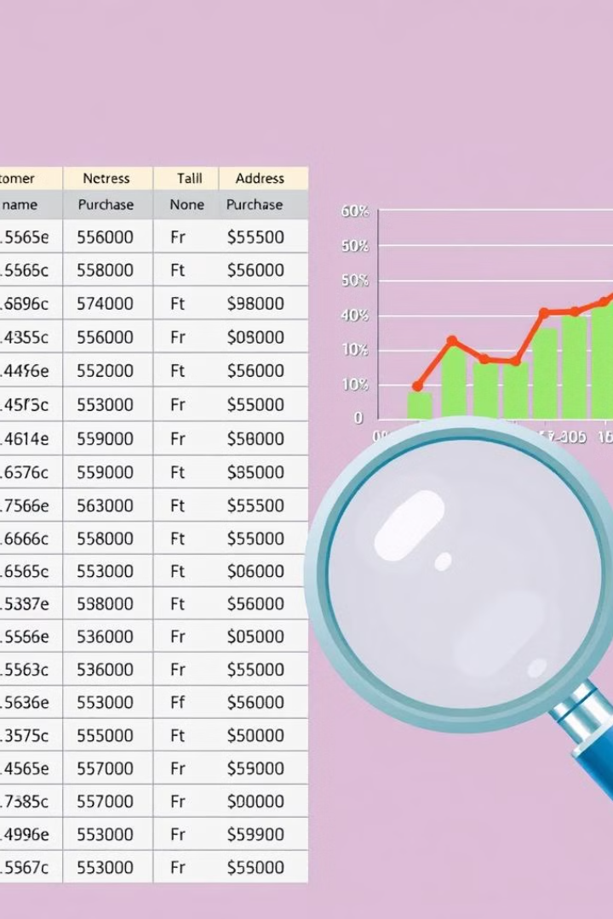
SQL Query: Returns & Churned Customers
SELECT cr.ReturnID, cr.CustomerID, cr.ReturnDate, cr.RefundAmount, cc.CustomerID, cc.Gender, cc.CityTier, cc.PreferredOrderCat, cc.PreferredPaymentMode, cc.Tenure, cc.CouponUsed, cc.OrderCount, cc.CashbackAmount FROM ecomm.customer_returns AS cr JOIN customer_churn AS cc ON cr.CustomerID = cc.CustomerID WHERE cc.ChurnStatus = 'Churned' AND cc.ComplaintReceived = 'Yes';
This SQL query retrieves key information. It helps to identify common traits. Returns and complaints lead to churn. Focus on improving customer support. Also focus on product satisfaction.

Slide 9




Conclusion & Recommendations
Address Churn
High churn linked to low satisfaction and complaints.
Targeted retention
Implement targeted retention strategies.
Improve Payment
Improve preferred payment and order experiences.

